Slide 1


Can we predict Stroke?
Debasish Panda
Bellevue University
DSC-680

Slide 2
Introduction
Stroke occurs when blood supply is interrupted to brain.
In the United States has a stroke every 40 seconds. Every 4 minutes, someone dies of a stroke.
Every year, more than 795,000 people in the United States have a stroke. About 610,000 of these are first or new strokes.
Stroke-related costs in the United States came to nearly $46 billion between 2014 and 2015.

Slide 3
Problem Statement
Aim of this project is to predict the certainty of a person to have this deadly disease based on various parameters such as age, gender, healthy habits, etc. so that this disease can be predicted before it becomes critical and be treated with normal measures and no lives are lost.
From the vast pool of machine learning algorithms, we chose few methods to predict accurately.

Slide 4
Risk factors for Stroke
Age
Sex
Race or Ethnicity
High Blood Pressure/Hypertension
High Cholesterol
Heart Disease
Diabetes
Unhealthy diet/Physical inactivity
Obesity
Tobacco use
Alcohol Use

Slide 5
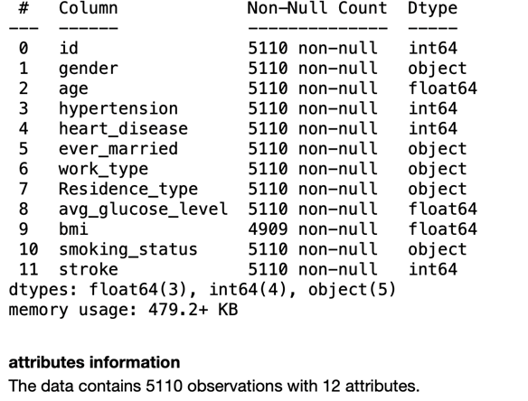
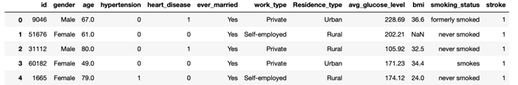
Dataset

Slide 6
Methods
K- Nearest Neighbor (K-NN)
Support Vector Machine (SVM)
Logistic Regression
Decision Tree
Random Forest
Gaussian NB
Bernoulli NB

Slide 7
EDA Summary
Patterns and correlation conclusion:
Attributes that have main correlations with stroke (>0.10):
age
avg glucose level
hypertension
heart disease background
ever married
stroke patterns:
The older a person is, the more likely to have a stroke.
Blood glucose level is dangerous at both edges (the safe zone is between 120 to 180 approximately.
Background of heart disease increases the risk of stroke by 13%.
Hypertension increases the risk of stroke by 10%.
1/2 of the stroke cases are around 30 BMI.
combination of BMI and AGE is a very powerful factor to predict stroke (high age, around 30 BMI).
In Dataset, 95% of data represents no stroke event and only 5% represents a stroke event. Part of the modeling, I will explore methods to smooth imbalance of data.

Slide 8
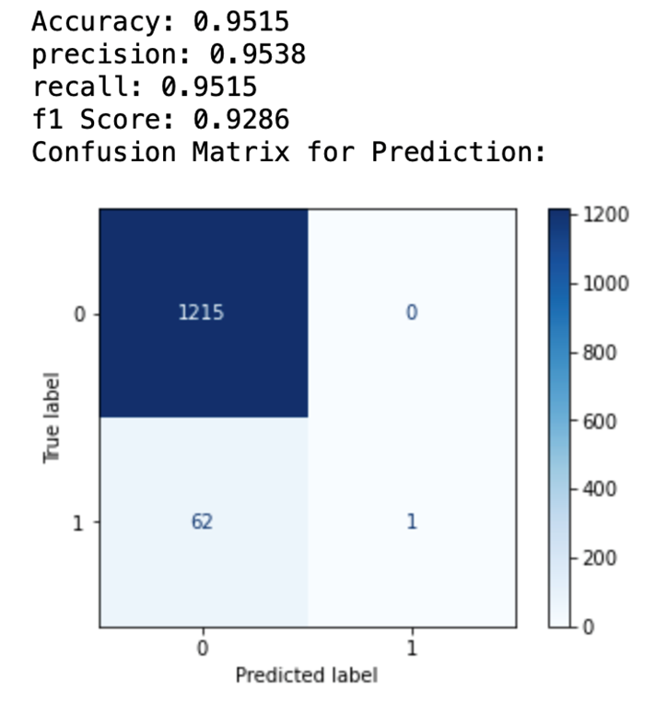
Results using KNN

Slide 9
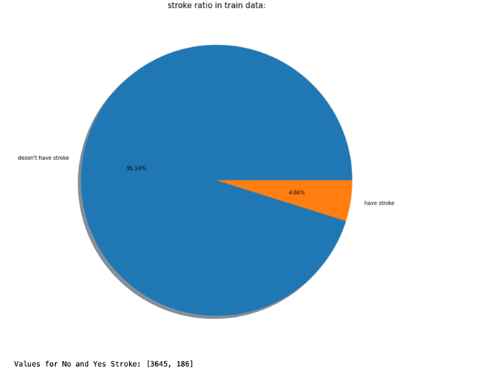
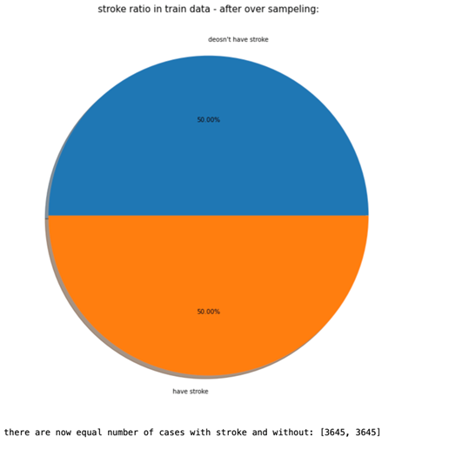
Class Rebalance -Before Train After SMOTE

Slide 10
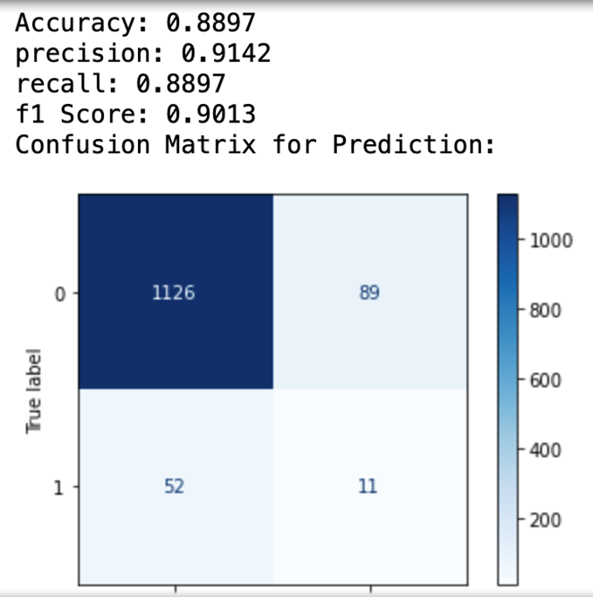
Results using KNN

Slide 11
Conclusion
Input Data classification is key for model training.
KNN Classifier has best balance of Accuracy and predictions.
Should attempt multiple models for training.
Model Can be deployed, but should consider looking for more features and balanced train data set.

Slide 12
References
Chris Albon. (2018). Machine Learning with Python Cookbook Practical Solutions from Preprocessing to Deep Learning.
Stroke Prediction Dataset | Kaggle. https://www.kaggle.com/fedesoriano/stroke-prediction-dataset
Stroke background information by CDC from https://www.cdc.gov/stroke/about.htm
Raj, S. (2020). How to Evaluate the Performance of Your Machine Learning Model - KDnuggets. https://www.kdnuggets.com/2020/09/performance-machine-learning-model.html
scikit-learn. (2021). API Reference — scikit-learn 1.0.1 documentation. https://scikit-learn.org/stable/modules/classes.html#module-sklearn.metrics
SMOTE - https://machinelearningmastery.com/smote-oversampling-for-imbalanced-classification/
Siegel, E. (2013). Predictive analytics: The power to predict who will click, buy, lie, or die.John Wiley & Sons.

Slide 13

Thank You!

